Slide 1
NON-CONN
NON-CONN
Instance: A directed graph G and two vertices s,t∈V.
Problem: To decide if there is no path from s to t.
Complexity
©D.Moshkovits
1

Slide 2
An Algorithm for NON-CONN
We’ll see a log space algorithm for counting reachability
Count how many vertices are reachable from s.
Take out t and count again.
Accept if the two numbers are the same.
Complexity
©D.Moshkovits

Slide 3
N.D. Algorithm for reach_{s}(v, l)
reach_{s}(v, l)
1. length = l; u = s
2. while (length > 0) {
3. if u = v return ‘YES’
4. else, for all (u’ ∈ V) {
5. if (u, u’) ∈E nondeterministic switch:
5.1 u = u’; --length; break
5.2 continue
}
}
6. return ‘NO’
Takes up logarithmic space
This N.D. algorithm might never stop
Complexity
©D.Moshkovits

Slide 4
N.D. Algorithm for CR_{s}
CR_{s} ( d )
1. count = 0
2. for all u∈V {
3. count_{d-1} = 0
4. for all v∈V {
5. nondeterministic switch:
5.1 if reach(v, d - 1) then ++count_{d-1} else fail
if (v,u) ∈ E then ++count; break
  5.2 continue
}
6. if count_{d-1} < CR_{s} (d-1) fail
}
7.return count
Assume (v,v) ∈ E
Recursive call!
Complexity
©D.Moshkovits

Slide 5
N.D. Algorithm for CR_{s}
, C)
Main Algorithm:
CR_{s}
C = 1
for d = 1..|V|
C = CR(d, C)
return C
CR_{s} ( d
1. count = 0
2. for all u∈V {
3. count_{d-1} = 0
4. for all v∈V {
5. nondeterministic switch:
5.1 if reach(v, d - 1) then ++count_{d-1} else fail
if (v,u) ∈ E then ++count; break
  5.2 continue
}
6. if count_{d-1} < fail
}
7.return count
C
parameter
Complexity
©D.Moshkovits

Slide 6
Efficiency
Lemma: The algorithm uses O(log(n)) space.
Proof:
There is a constant number of variables ( d, count, u, v, count_{d-1}). Each requires O(log(n)) space (range |V|). 
Complexity
©D.Moshkovits

Slide 7
Immerman’s Theorem
Theorem[Immerman/Szelepcsenyi]: NL=coNL
Proof:
(1) NON-CONN is NL-Complete
(2) NON-CONN∈NL
Hence, NL=coNL. 
Complexity
©D.Moshkovits

Slide 8
Corollary
Corollary:
∀s(n)≥log(n), NSPACE(s(n))=coNSPACE(s(n))
Proof: By a padding argument.
Complexity
©D.Moshkovits

Slide 9
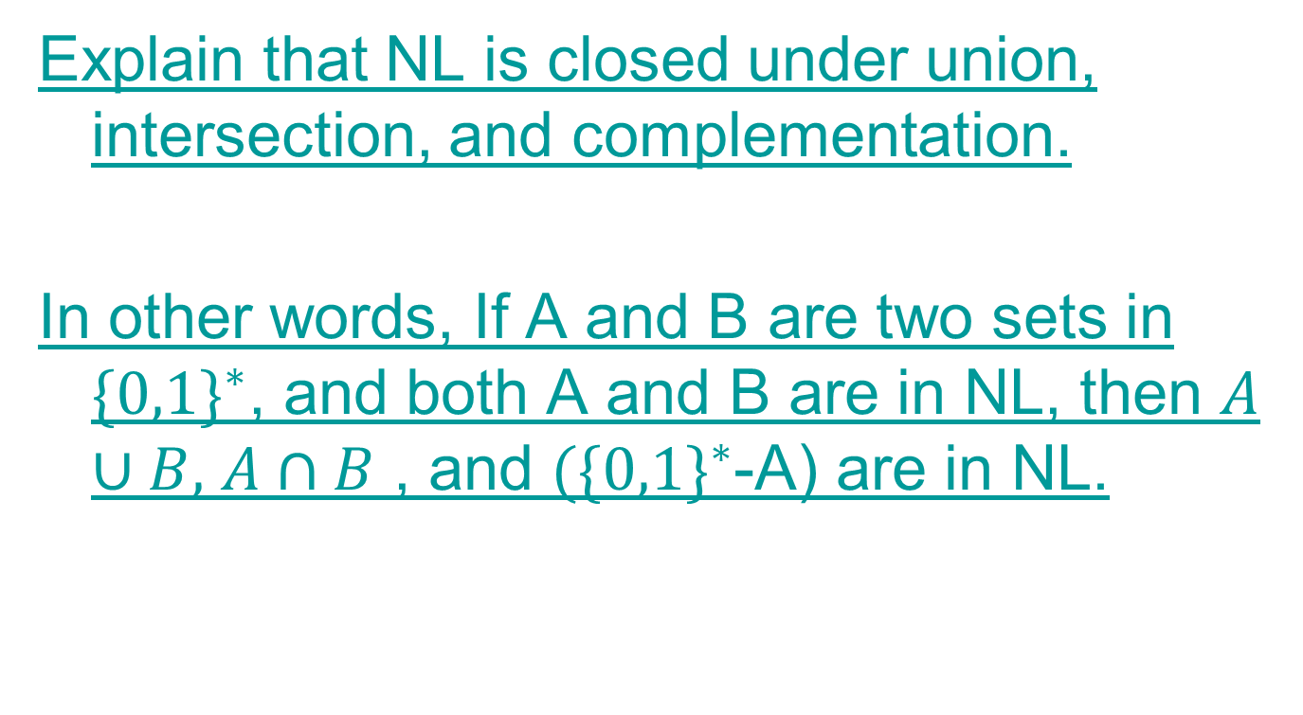
Problem
Complexity
©D.Moshkovits

